Slide 1
User Guide
International Conference on
Application Frameworks

Slide 2
Front Panel User
International Conference on
Application Frameworks

Slide 3

Welcome to the ICAF !
When you first launch our webapp, you will be greeted by the Landing Page
When you click on the "View Conference" button, you will be directed to the login page

Slide 4

Home Page
In this page, You will be able to see the key details of the conference, along with a navigation bar which will direct you to different pages with information about the conference.

Slide 5
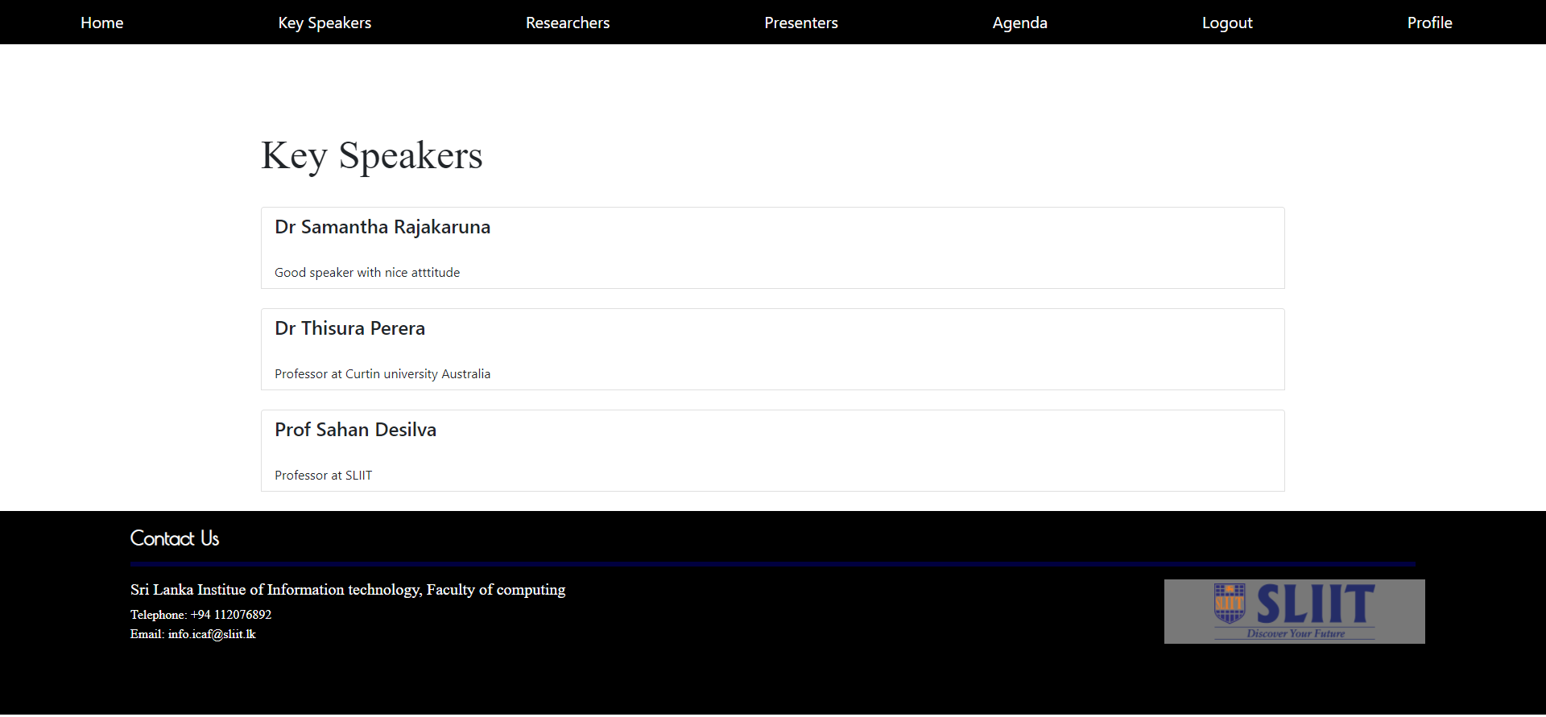
Key speakers
This page contains the details of the Key Speakers

Slide 6
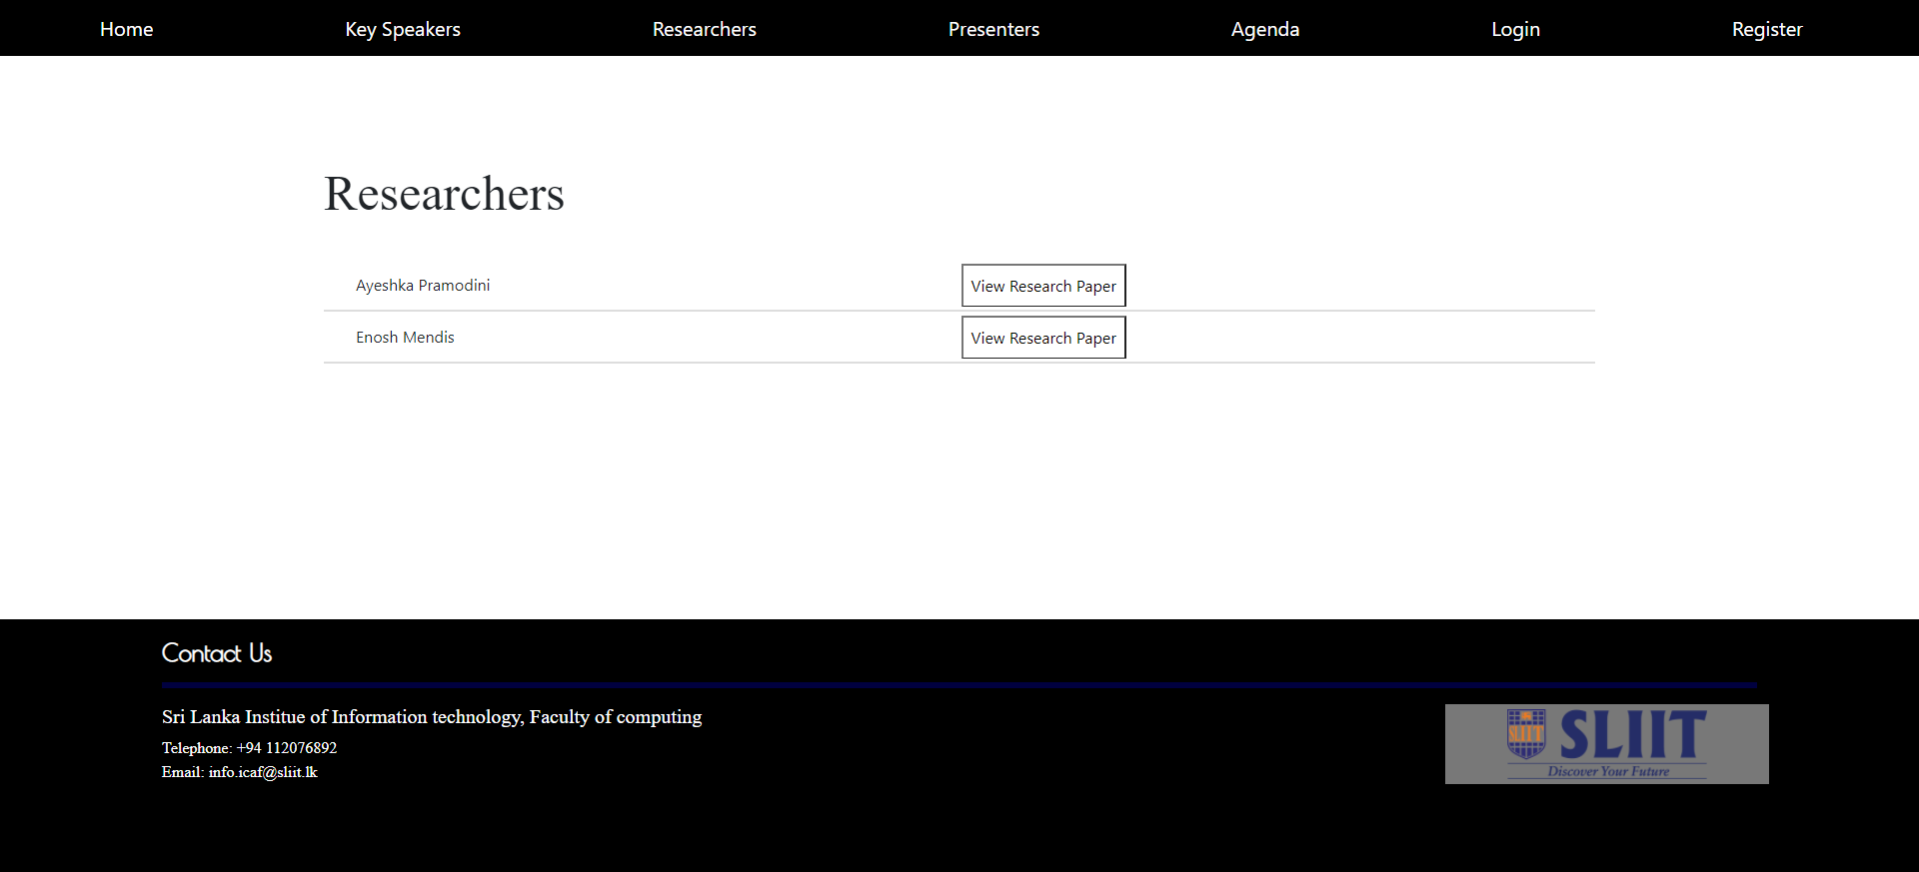
Reseachers
This page displays the information of the researchers who have been accepted to present their work at the conference
If the user wants to download the research paper, they can click it and download the paper

Slide 7
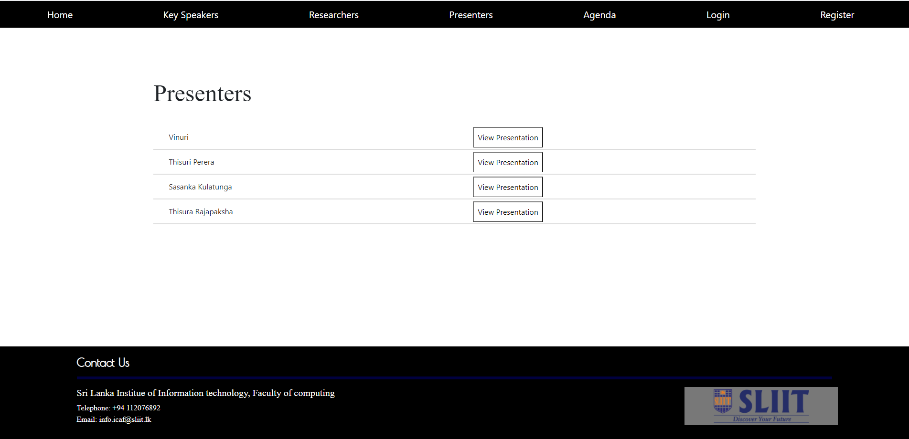
Workshop Presenters
This page displays the information of the workshop presenters who have been accepted to present their work at the conference
If the user wants to download the workshop proposal, they can click it and download the paper

Slide 8
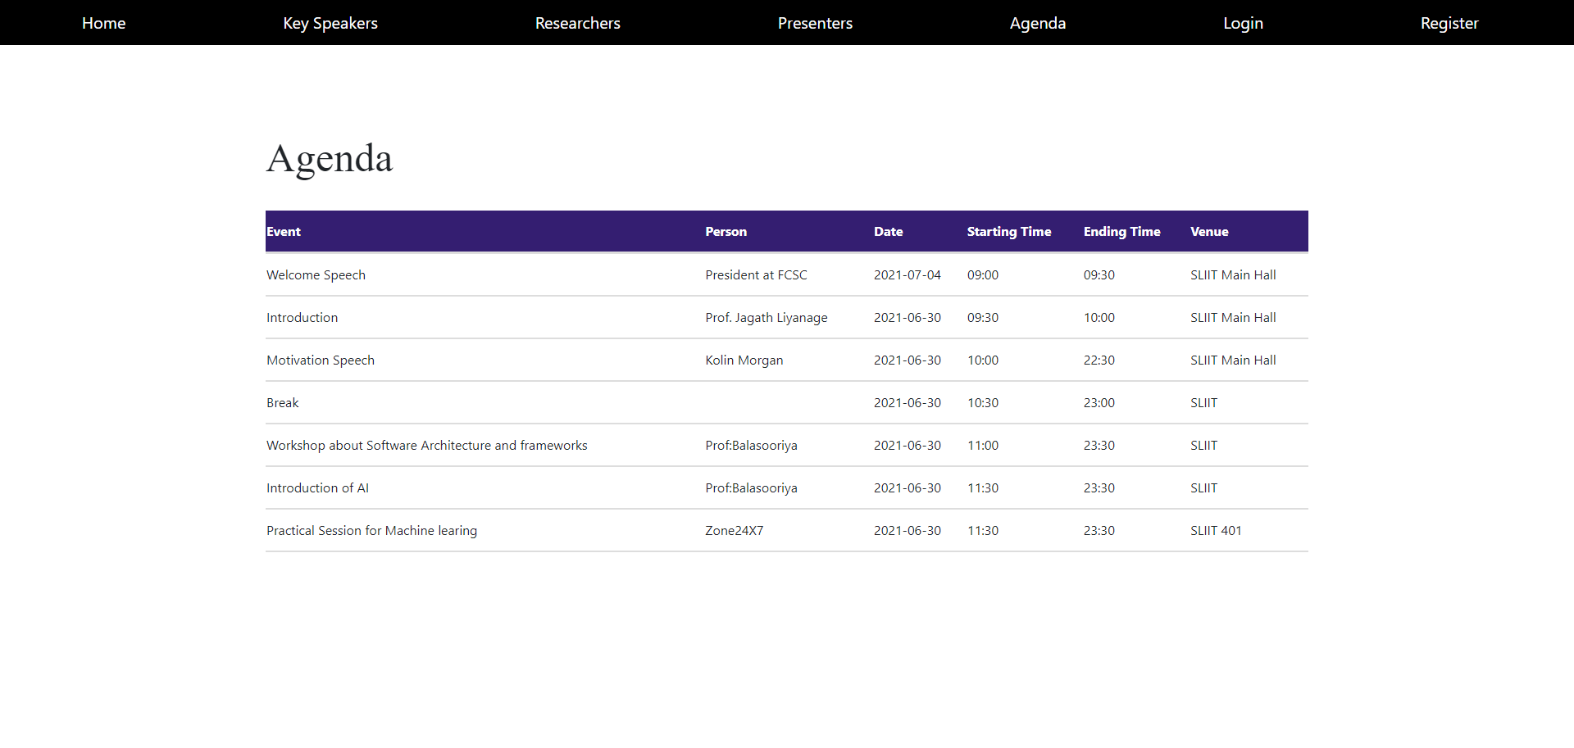
Agenda
This displays the agenda, the time the events are held on.

Slide 9
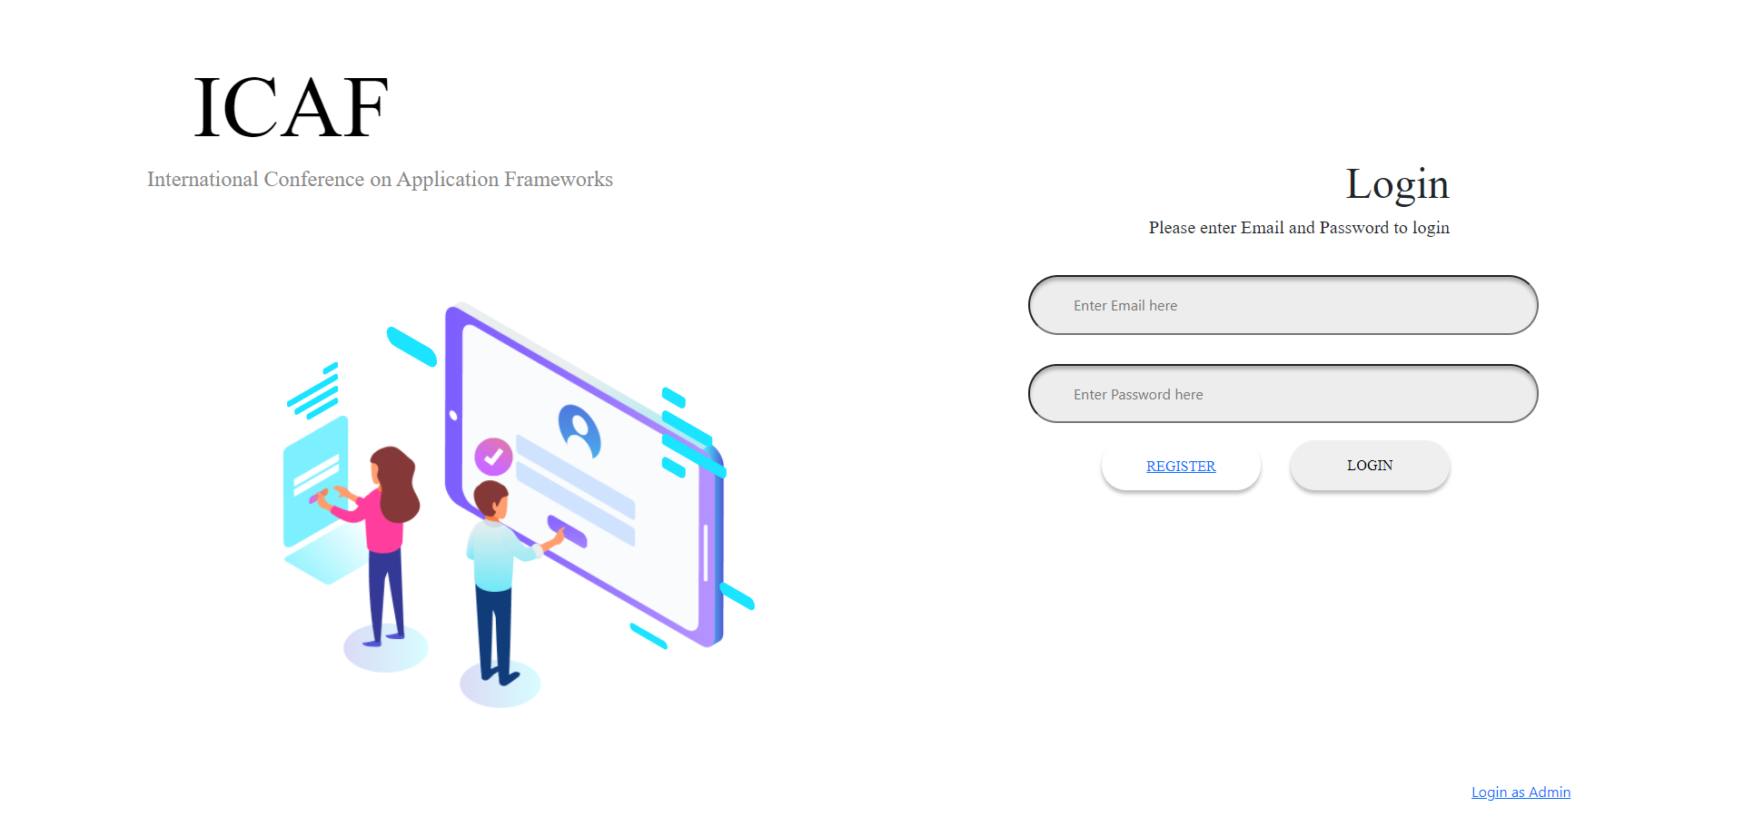
Login
Step 1: Enter Email and Password.
(Should be email and password provided at registration)
Step 2: Click on login button

Slide 10
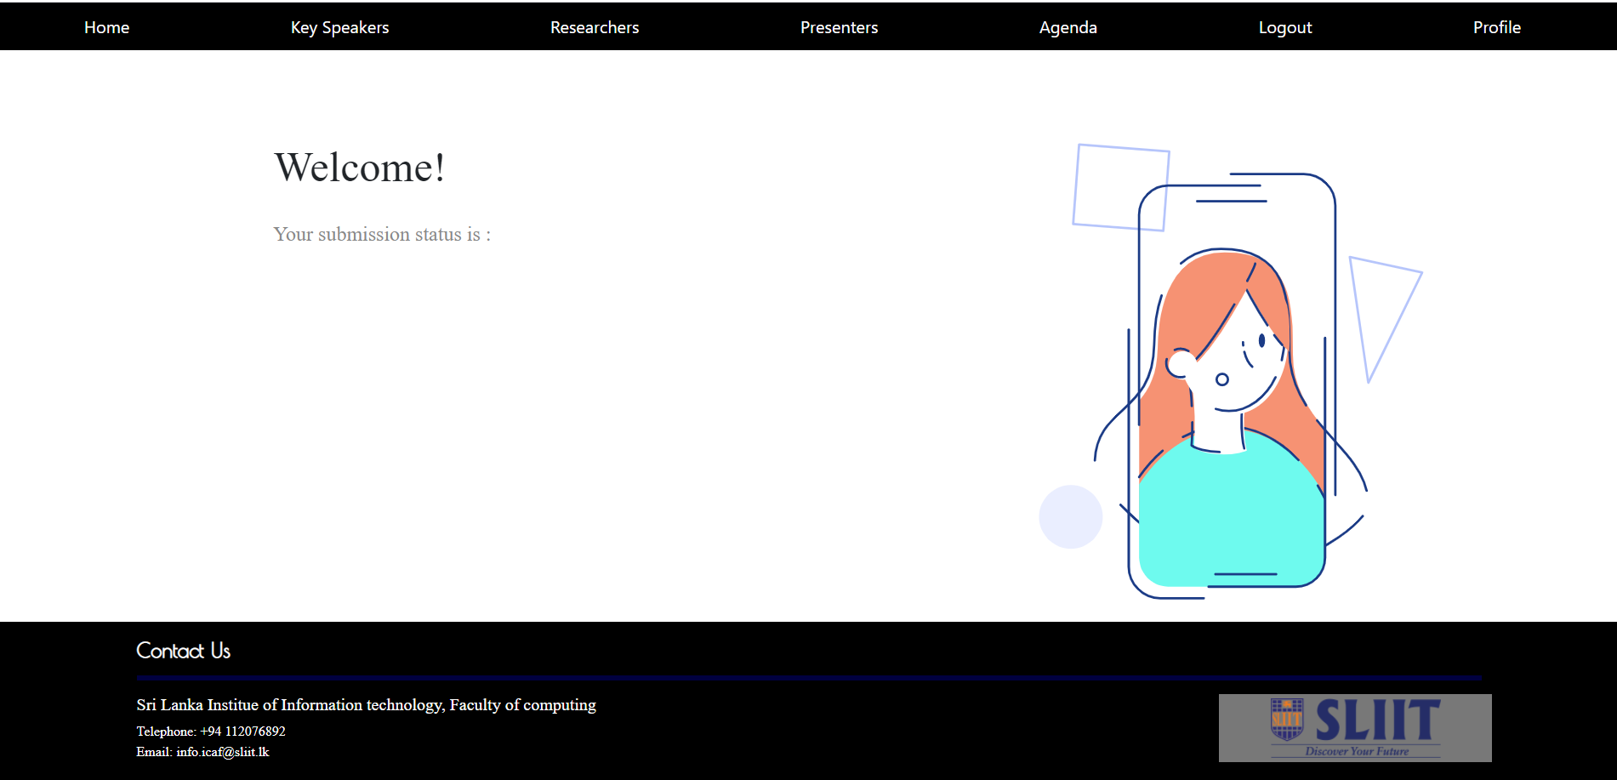
Profile
Once you Log in, you will be able to see the status of the submission through the profile page

Slide 11
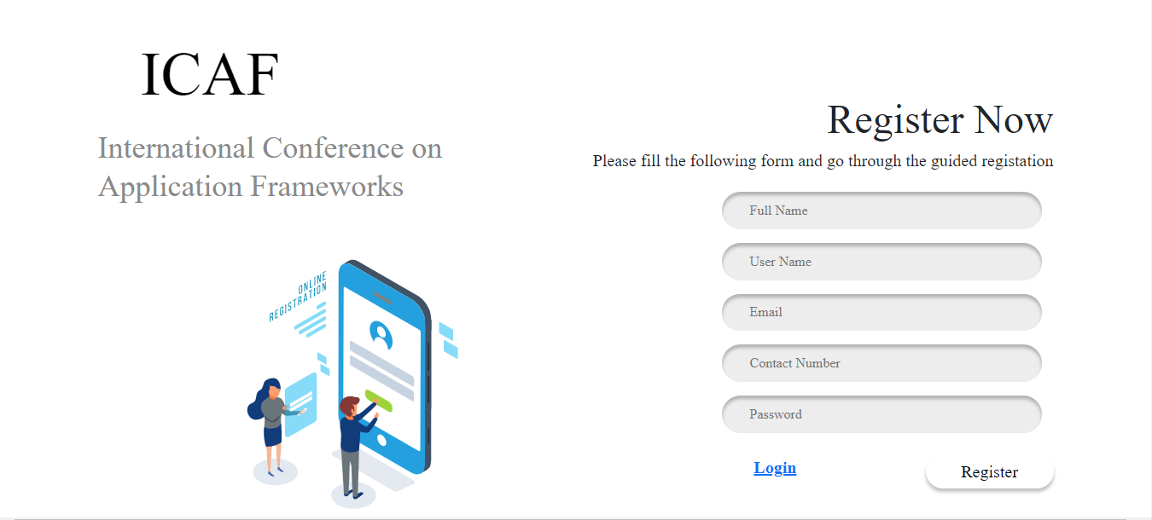
Registration
STEP 1
Step 1: Fill the columns in the form. (All columns must be filled)
Step 2 : Click on the submit button.
STEP 2

Slide 12
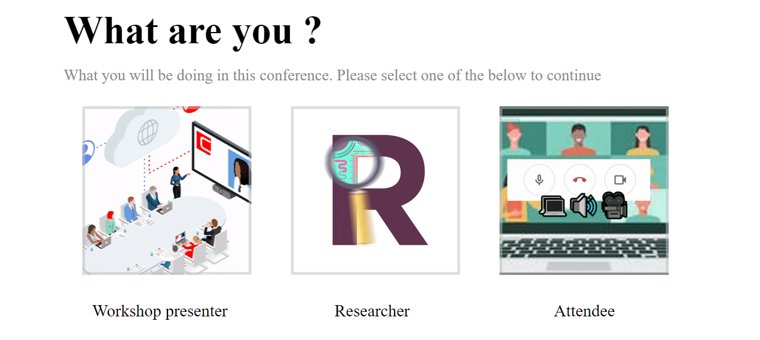
Select User Type
Step 1: Select the user type that you want be registered as
(E.g: Researcher, Workshop presenter, Attendee)

Slide 13
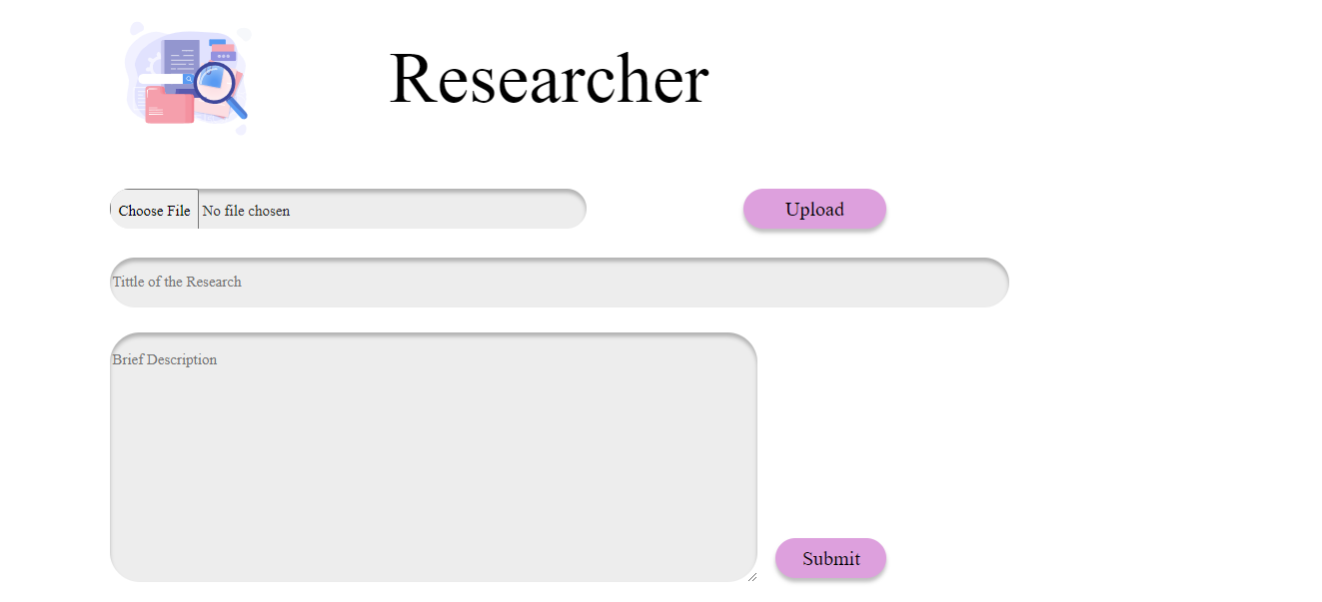
Upload Research Paper
(User Type:
Researcher)
STEP 1
STEP 2
Step 1: Select a research paper to upload. (Allowed only pdf)
Step 2: Click on the upload button.
Step 3: Fill the title and the description fields
Step 4: Click on the submit button
STEP 3
STEP 4

Slide 14
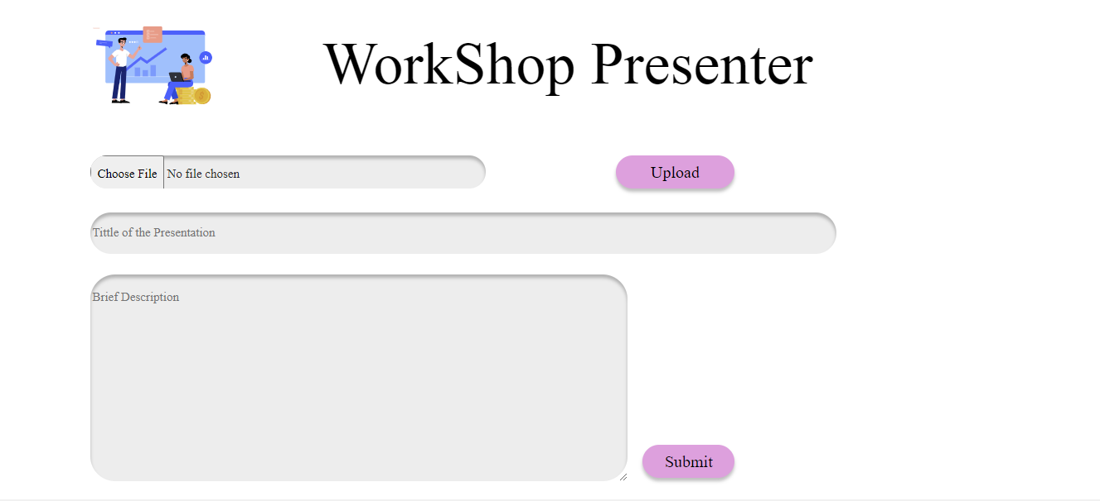
Upload Workshop Proposal
(User Type:
Researcher)
STEP 1
STEP 2
Step 1: Select a proposal to upload. (Allowed only ppt and pptx)
Step 2: Click on the upload button.
Step 3: Fill the title and the description fields
Step 4: Click on the submit button
STEP 3
STEP 4

Slide 15
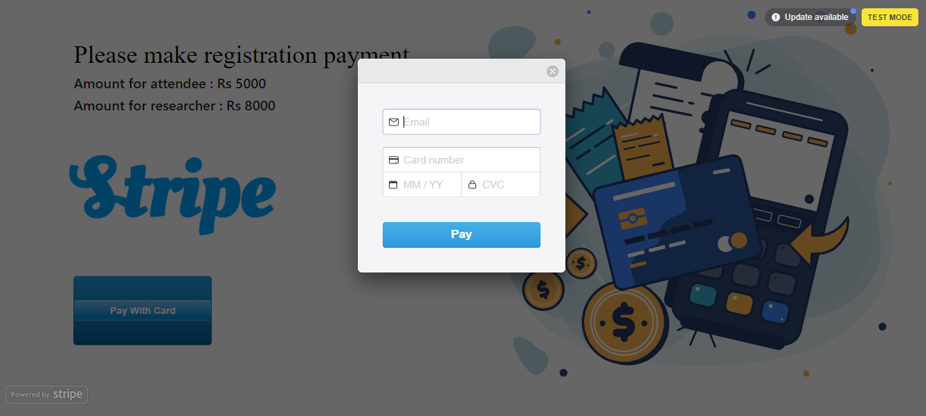
Payment
(User Type:
Attendee)
STEP 2
Step 1: Click the payment button.
Step 2: Fill the pop up box with the relevant card details. (All fields must be filled)
Click on the pay button.
STEP 1
STEP 2

Slide 16
Back Panel User
International Conference on
Application Frameworks

Slide 17
Welcome to the ICAF !
When you first launch our webapp, you will be greeted by the Landing Page
When you click on the "View Conference" button, you will be directed to the login page

Slide 18
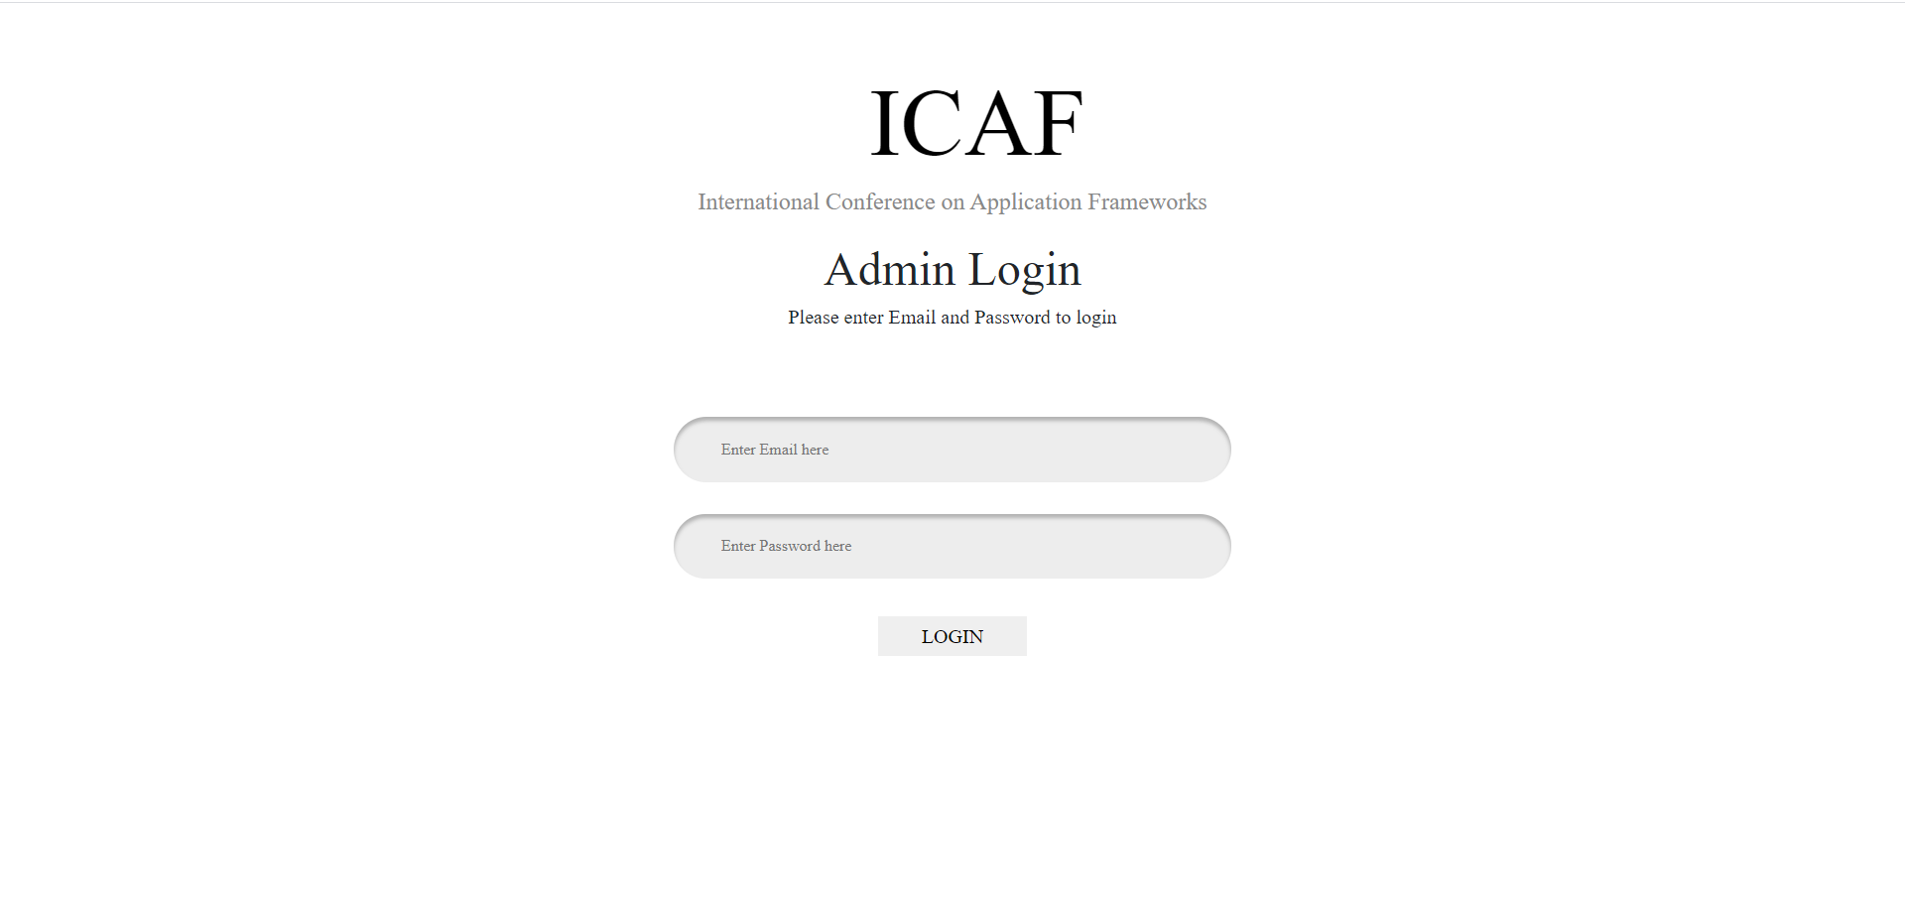
Login Page
In this page, You will be able to see can login as Admin reviewer or editor . You can select relevant type and entering login credentials can log in to the system.

Slide 19
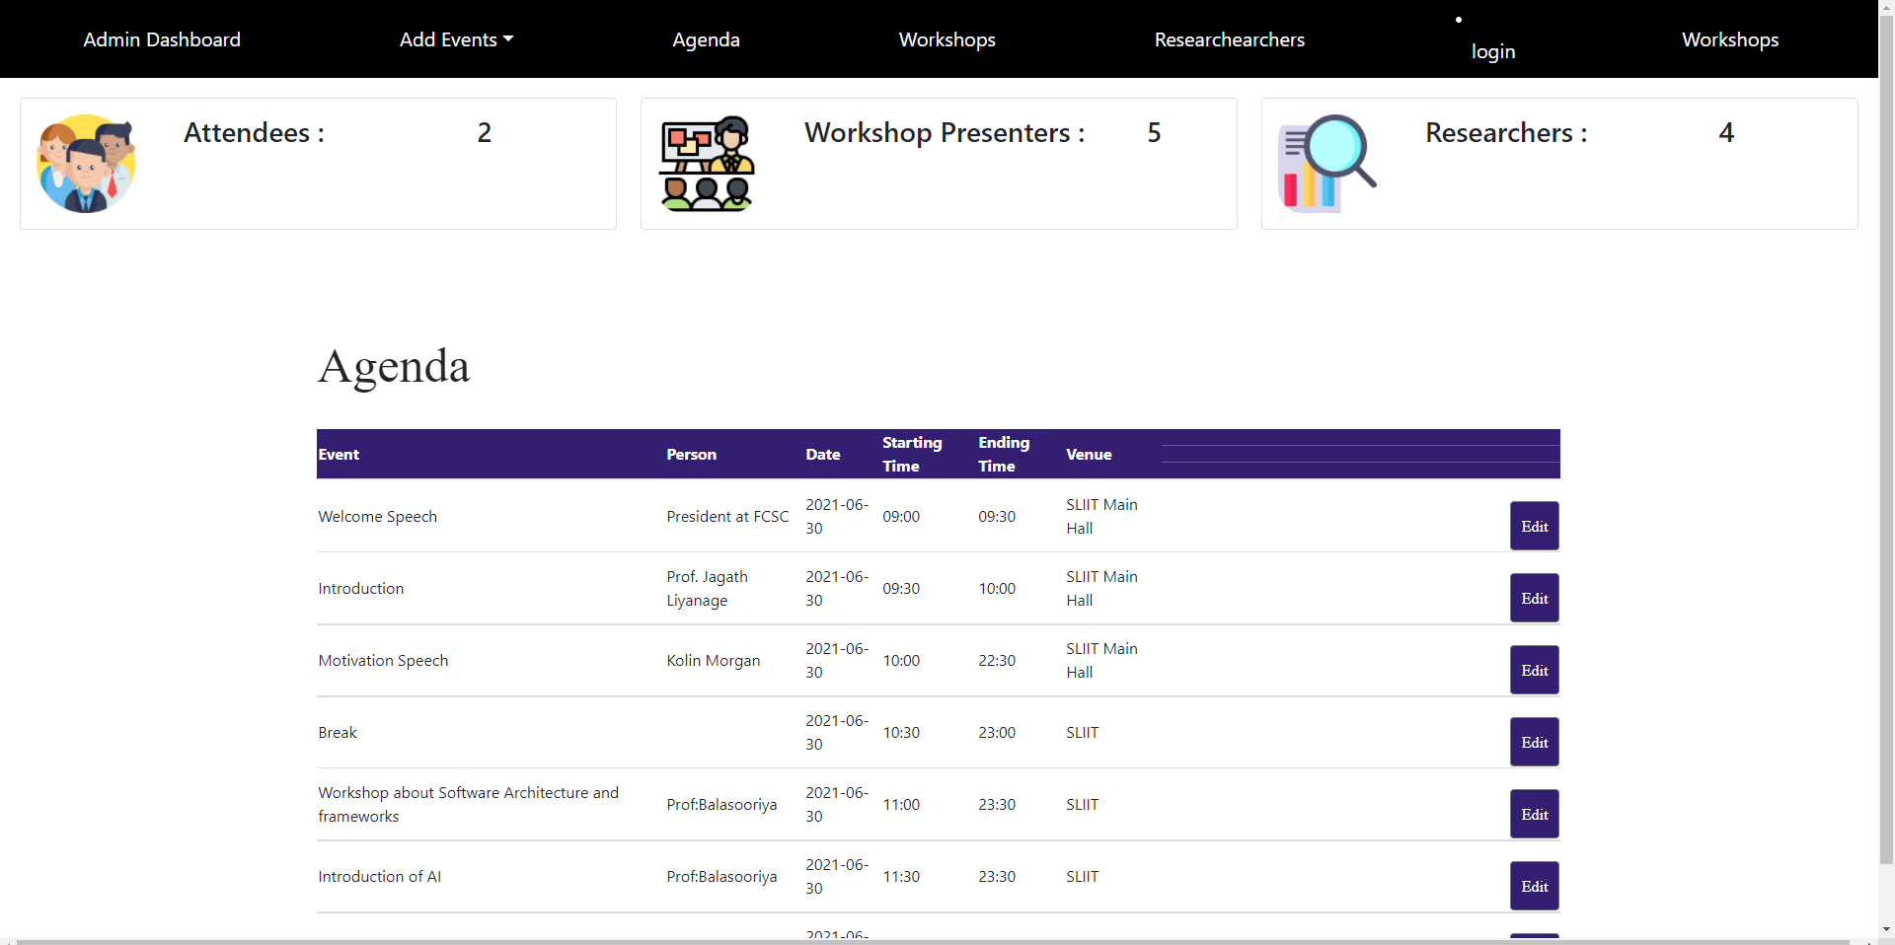
Admin Dashboard
When User logged as an admin can see this dashboard. In this top of the page have Total Attendee count, Total Researchers count and Total Workshop Presenters Count. Bellow that counts display agenda and display edit buttons to each events in agenda. Admin can click Edit button and can go Edit Event in agenda page.
Also have Approve conference tab and clicking that tab direct to conference details page that he accept and reject conference details.

Slide 20
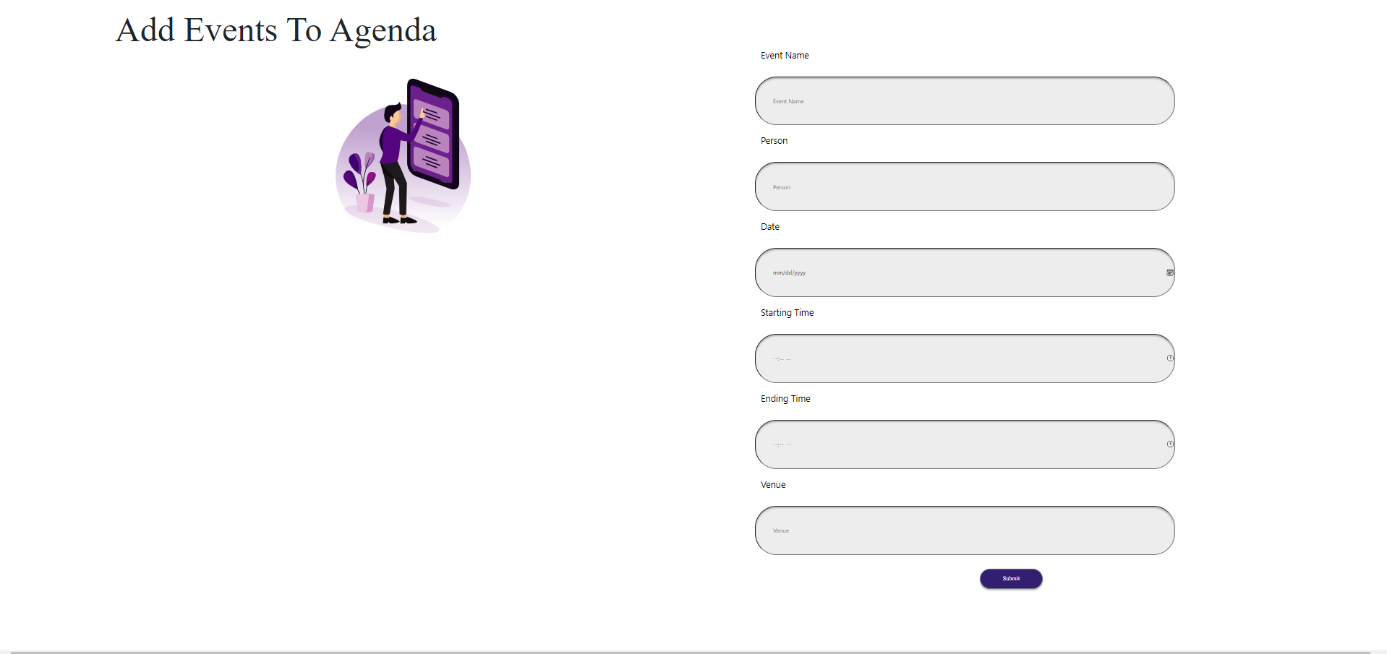
Add Events To Agenda
Step 1 : Admin can direct to Add Events to agenda page by clicking dashboard navigation bar add Events tab.
Step 2 :Fill the columns in the form.
Step 3 : Click Submit Button.
STEP 2
STEP 3

Slide 21
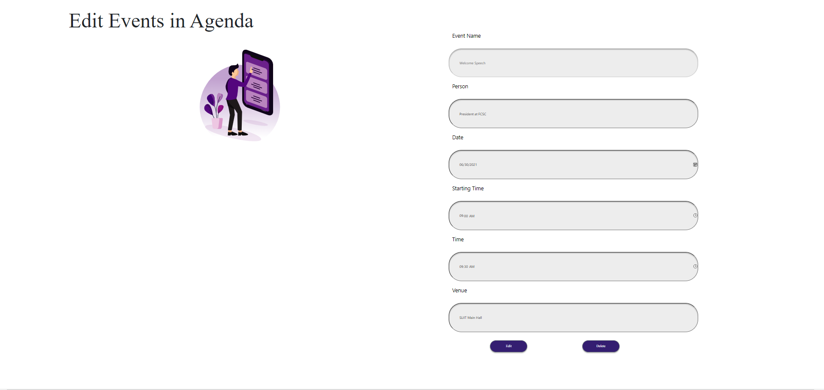
Edit Events In agenda
Step 1: Go to Dashboard and Then van View Events In Agenda.
Step 2 : Click on the Edit button which want to edit Event.
Step 3 : If want to only Edit change relevant input fields in forum Click Edit Button.
STEP 2
STEP 3

Slide 22
Delete Event in Agenda
Step 1: Go to Dashboard and Then van View Events In Agenda.
Step 2 : Click on the Edit button which want to delete Event.
Step 3 : Redirect to Edit Event In agenda page.
Step 4 : Click delete button
STEP 2
STEP 3

Slide 23
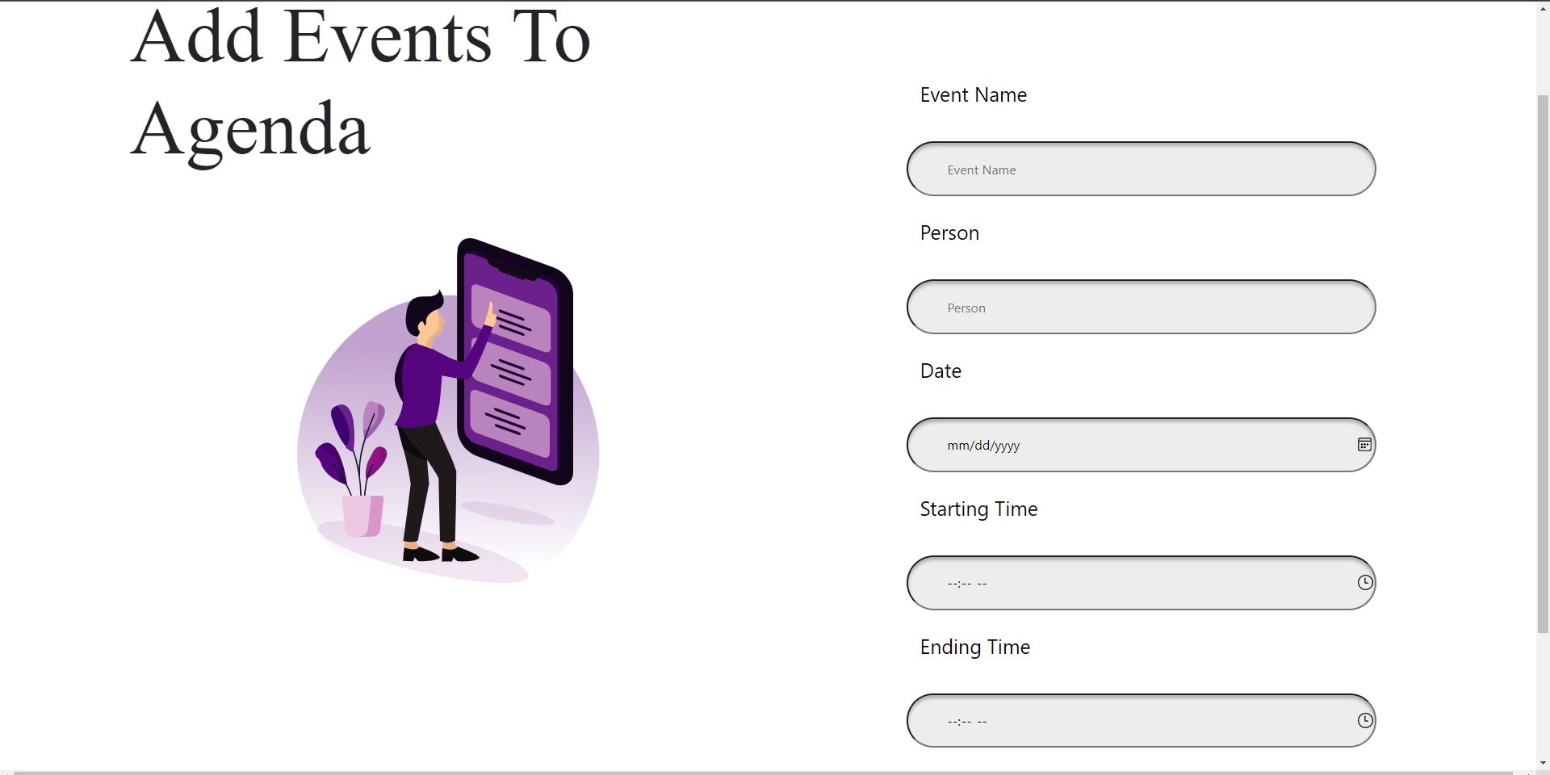
Add Back Panel Users
Step 1 : Admin can direct to Add Back Panel Users page by clicking dashboard navigation bar add back panel user tab.
Step 2 :Fill the columns in the form.
Step 3 : Click Submit Button.

Slide 24
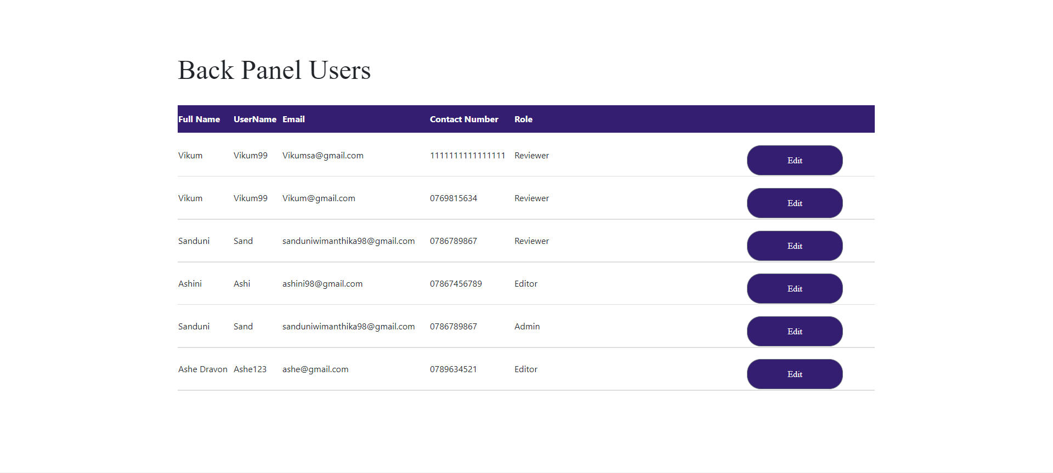
View Back Panel Users.
Step 1: Go to Dashboard
Step 2 : Click on back panel users tab in nav bar.
Step 3: You can see List of Users.

Slide 25
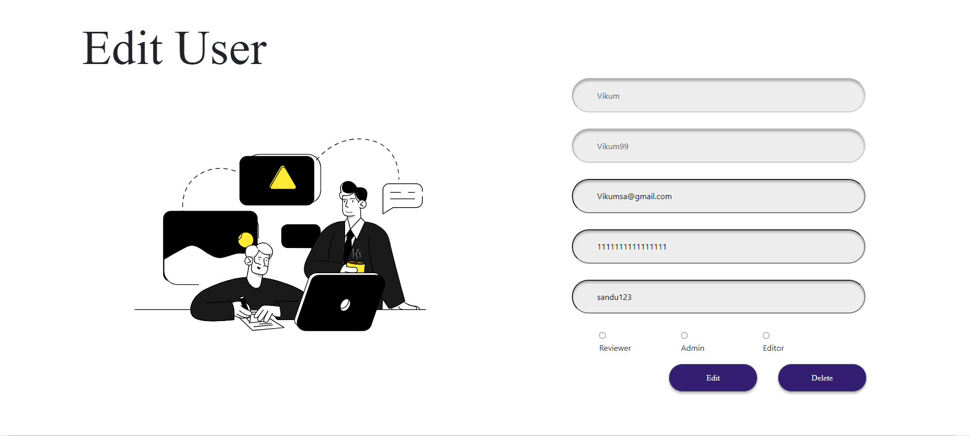
Edit Back Panel Users.
Step 1: Go to Back Panel User List.
Step 2 : Click on the Edit button which want to edit relevant User.
Step 3 : If want to only Edit change relevant input fields in forum
Step 4: Click Edit Button.
STEP 3
STEP 4

Slide 26
Delete Back Panel User
Step 1: Go to back panel user list.
Step 2 : Click on the Edit button which want to delete user.
Step 3 : Redirect to Edit Eback panel user page.
Step 4 : Click delete button
STEP 3
STEP 4

Slide 27
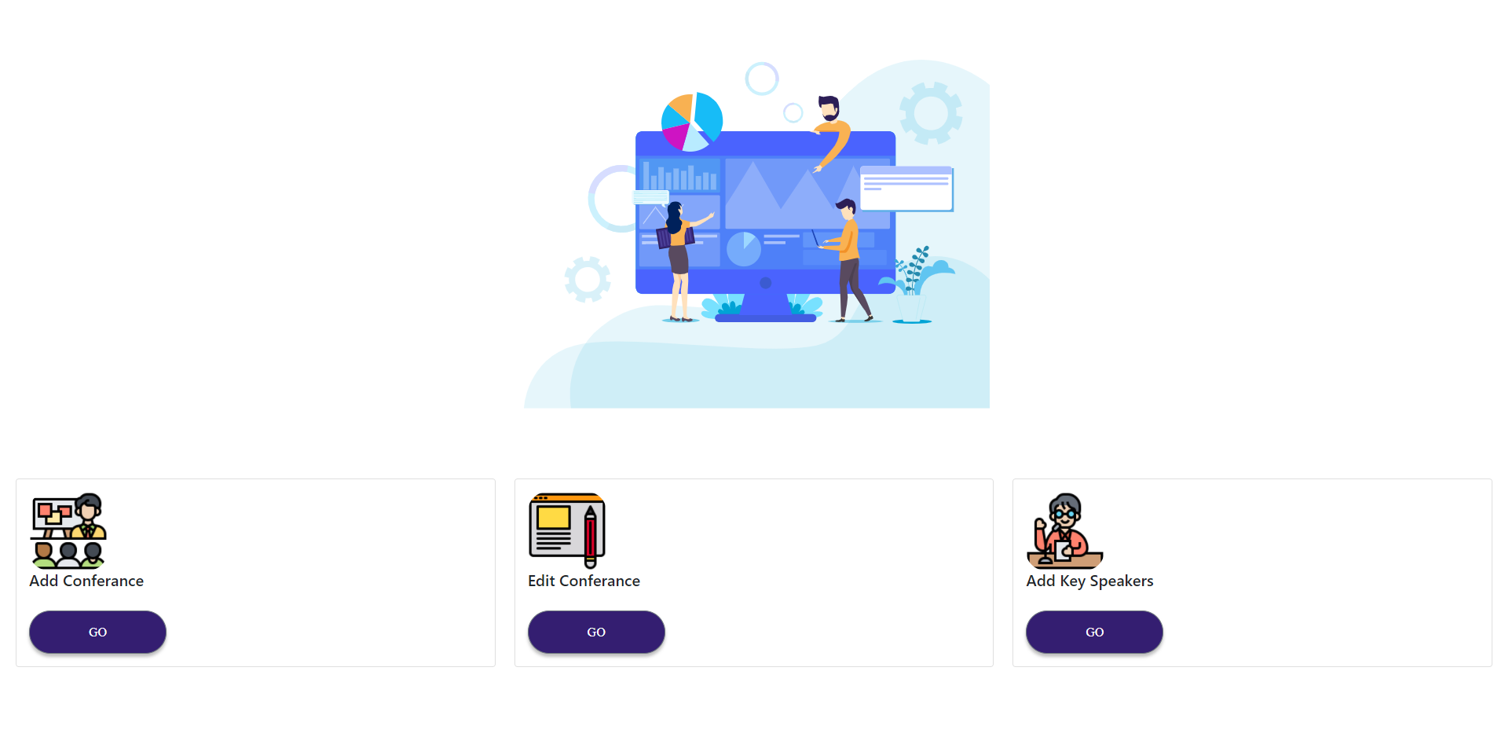
Editor Dashboard
When user logged as an Editor can see this dashboard.
Using add conference tab,edit conference tag and Add key key speaker tab can navigate to that relavant pages by clicking go button.

Slide 28
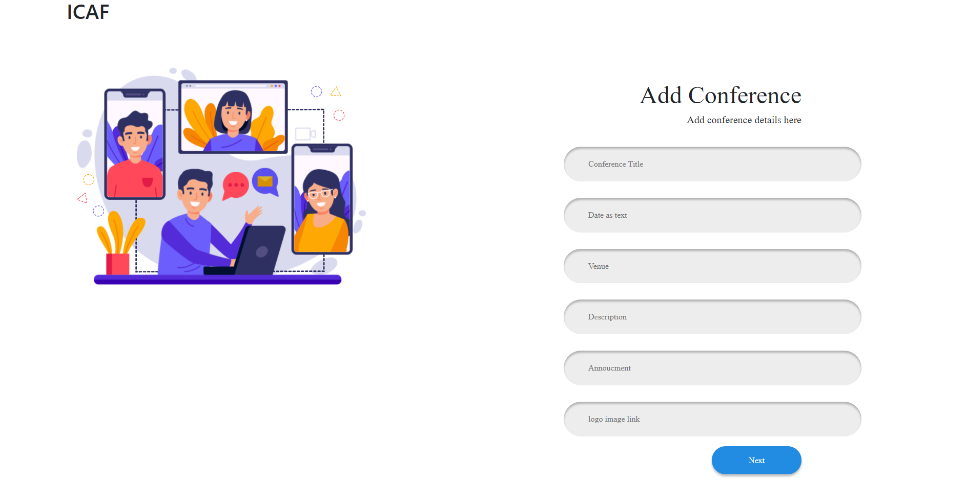
Add Conferance
Step 1: To Add conference details Click add conference go button in editor dashboard.
Step 2 :Add conference details by filling the columns in the form.
Step 3 : Click Submit button.
STEP 2
STEP 3

Slide 29
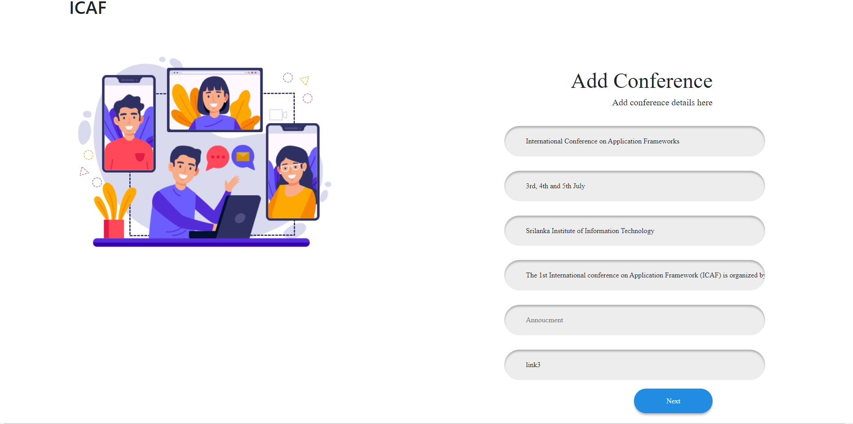
Edit Conferance
Step 1: To Edit conference details Click add conference go button in editor dashboard.
Step 2 : If want to only Edit change relevant input fields in forum.
Step 3 : Click Editbutton.
STEP 2
STEP 3

Slide 30
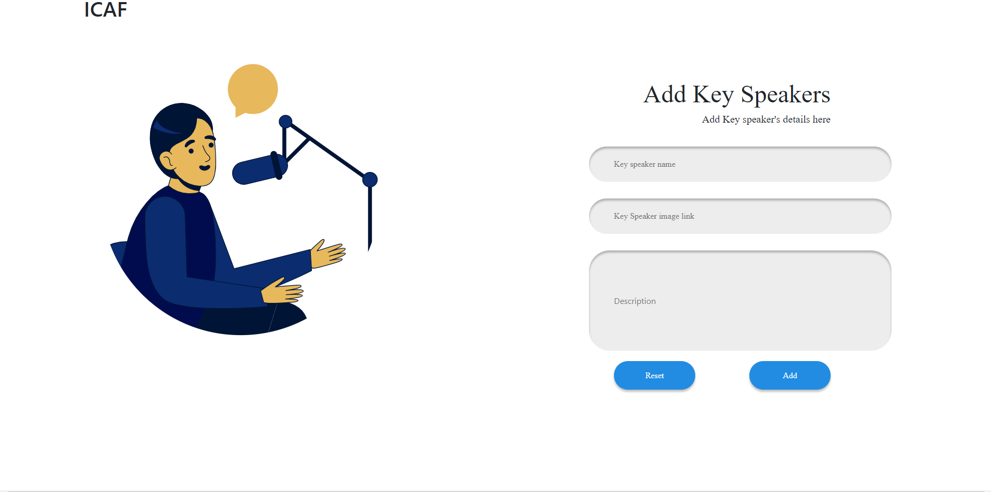
Add key speakers
STEP 2
STEP 3
Step 1: To Add key speakers Click add conference go button in editor dashboard.
Step 2 : Add conference details by filling the columns in the form.
Step 3 : When put image url upload image to this https://imgur.com/upload
Step 3 : Then get upload image url and put inputfeild.
Step 4 : Click Submit button.
STEP 2

Slide 31

Reviewer Dashboard
When user logged as an Reviewer can see this dashboard.
Using Researchers tab and Workshops tab can redirect to relevant pages by clicking that tabs.

Slide 32
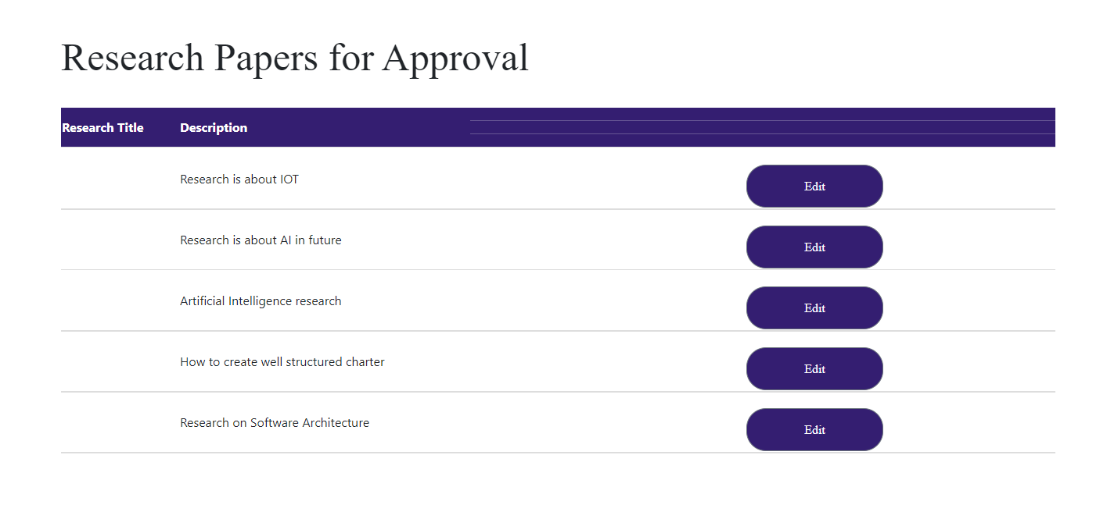
Research Review
Step 1 : Click Research tab in reviewer dashboard.
Step 2 : Then can view all research papers in pending status.

Slide 33
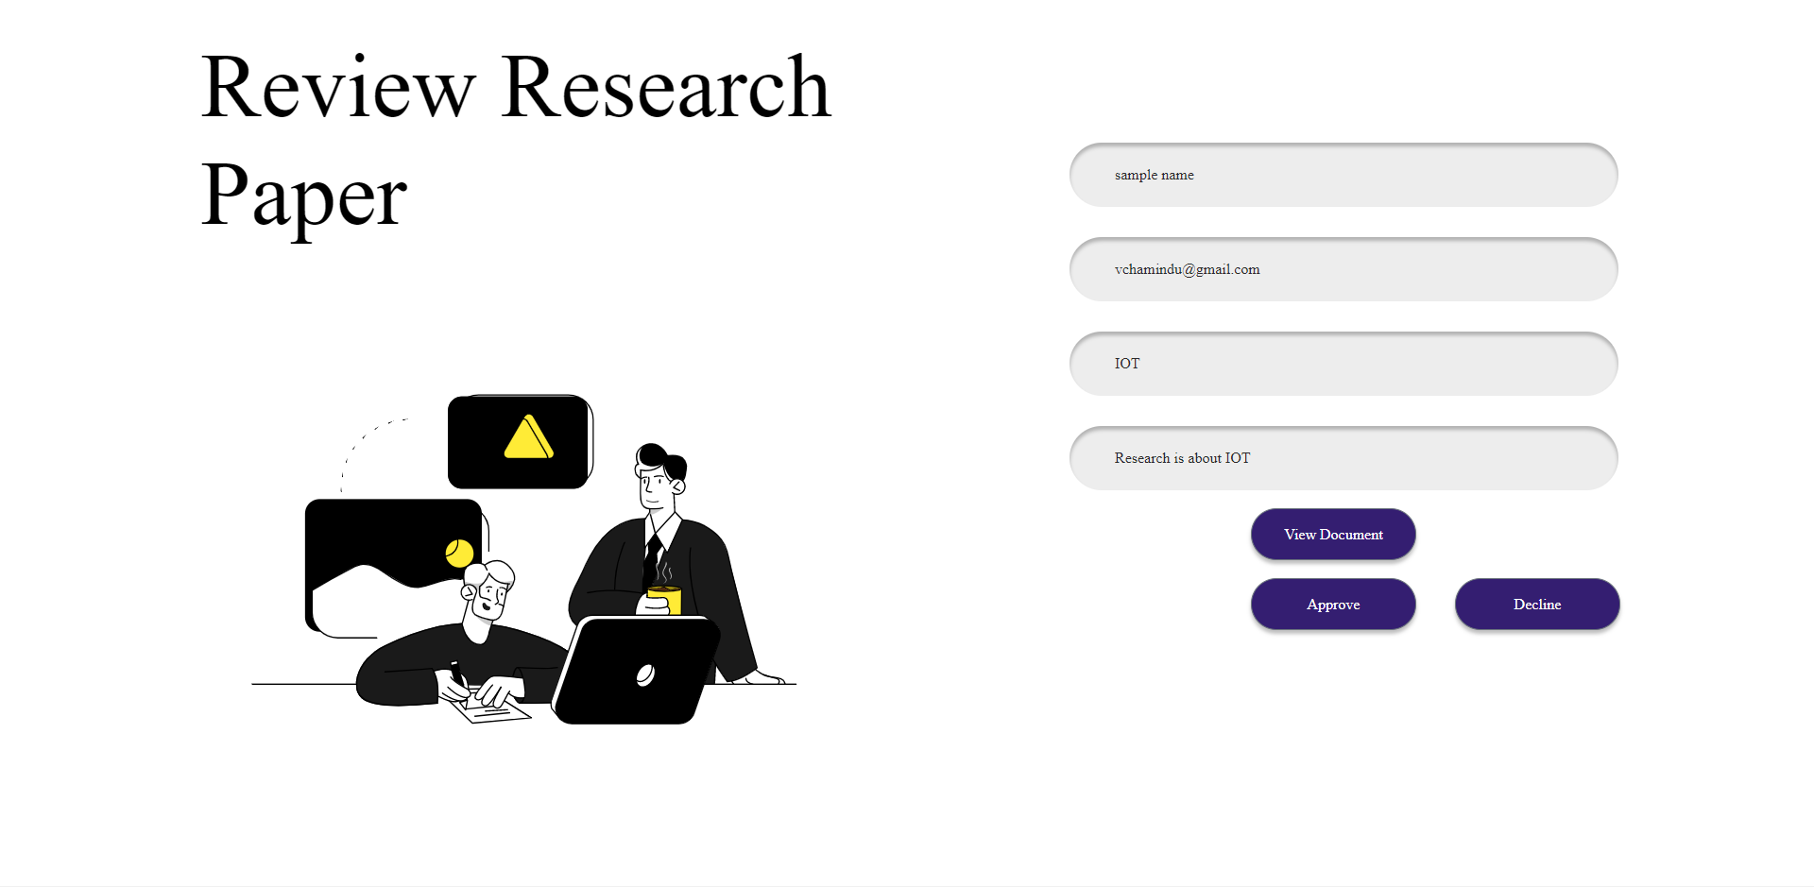
Review Research Paper
STEP 3
Step 1 : Go to Research Review.
Step 2 : Click Edit Button That you want to review research paper.
Step 3: Relevant research paper details will display.
Step 4: To view research paper click View Document button.
Step 5 : You want to approve click Approve button and You want to decline click Decline button.
STEP 4
STEP 5

Slide 34
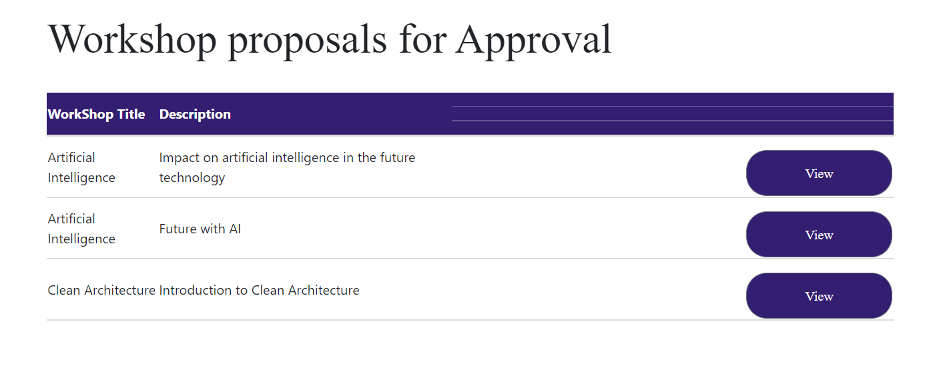
Workshop Proposal Review
Step 1 : Click Workshop tab in reviewer dashboard.
Step 2 : Then can view all Workshop Proposals in pending status.

Slide 35
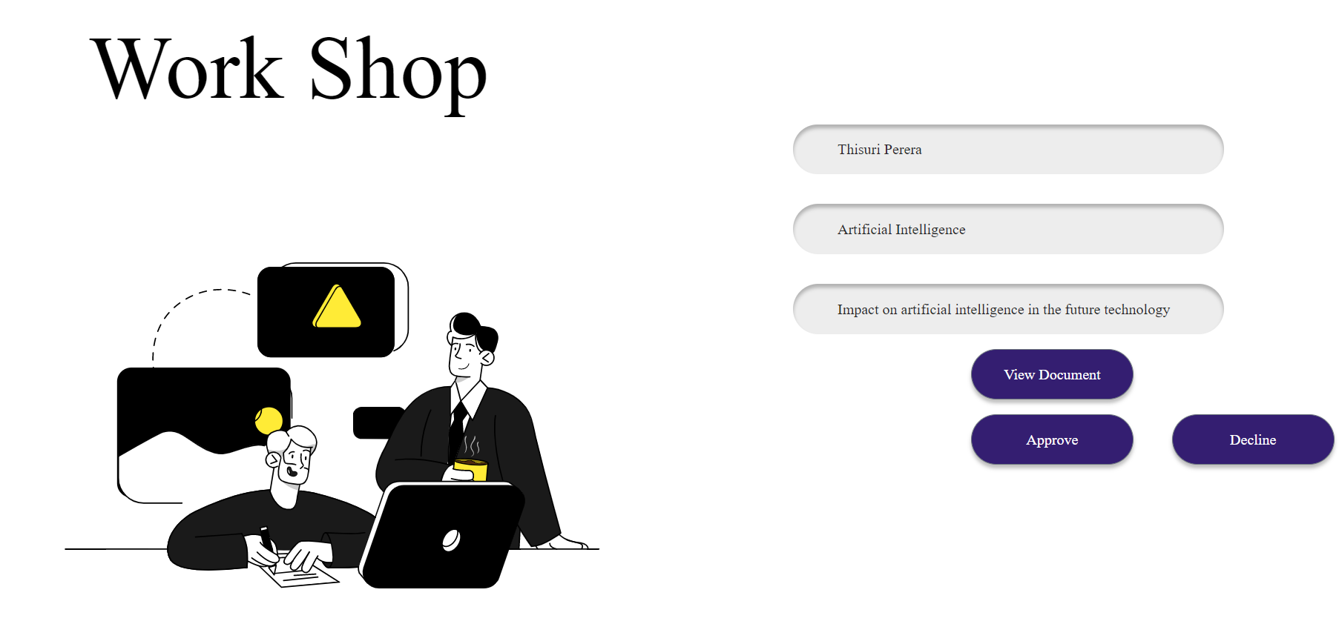
Review Workshop Proposal
STEP 3
Step 1 : Go to Workshop Proposal Review.
Step 2 : Click Edit Button That you want to review Workshop Proposal.
Step 3: Relavant Workshop Proposal details will display.
Step 4: To view Workshop Proposal click View Document button.
Step 5 : You want to approve click Approve button and You want to decline click Decline button.
STEP 4
STEP 5

Slide 36
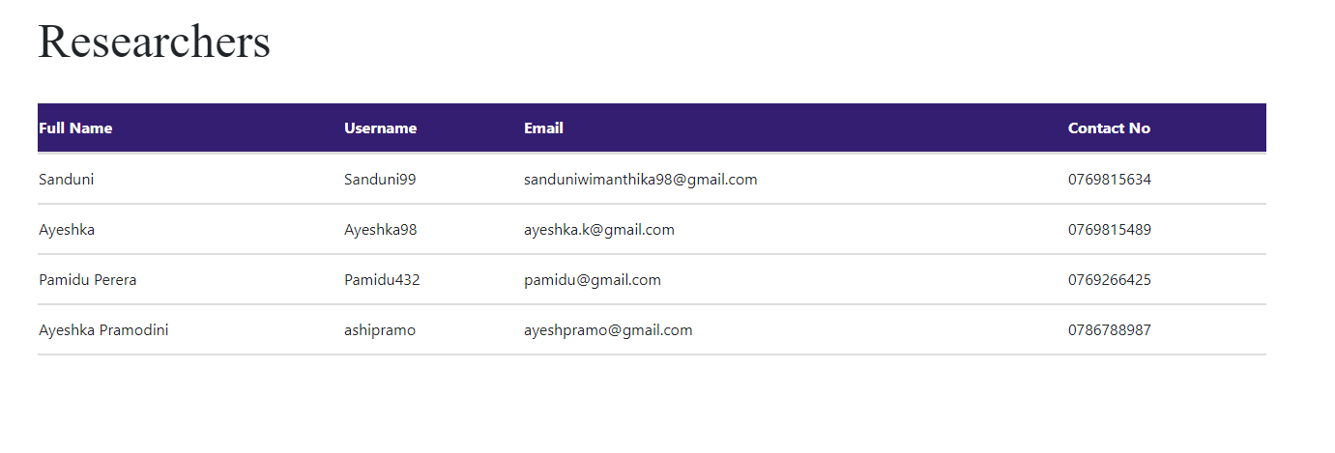
Reseachers
This page displays the information of the researchers who have been accepted to present their work at the conference

Slide 37
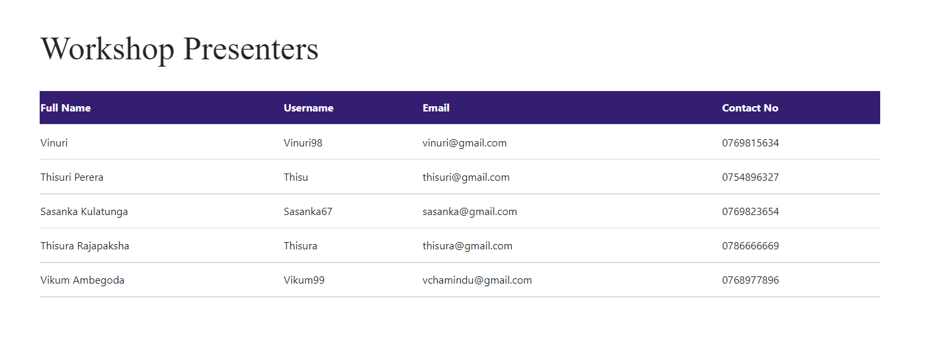
WorkShop Presenters
This page displays the information of the workshop presenters who have been accepted to present their work at the conference

